Slide 1
ABSTRACT
Software Testing is a process, which involves, executing of a software program application and finding all errors or bugs in that program/application so that the result will be a defect-free software.
Through the advancement of technology around the world, there increased the number of verification techniques and methods to test the software before it goes to production and off course to market.
Manual testing, as the term suggests, refers to a test process in which a QA manually tests the software application in order to identify bugs.
Automation Testing has made its impact in the testing process.
Now-a-days, most of the software testing is done with the automation tools which not only lessens the number of people working around that software but also the errors that can be escaped through the eyes of the tester.
This is aims in knowing different types of software testing, software testing techniques and tools and to compare manual testing versus automation testing.

Slide 2
EXISTING SYSTEM:
In this testing system we have using the Manual Testing,
Manual testing, as the term suggests, refers to a test process in which a QA manually tests the software application in order to identify bugs.
To do so, QAs follow a written test plan that describes a set of unique test scenarios. The QA is required to analyze the performance of the web or mobile application from an end user’s perspective.
QAs verify the actual behavior of software against expected behavior, and any difference is reported as a bug.

Slide 3
DRAWBACK OF EXISTING SYSTEM
Manual testing requires human intervention for test execution.
Manual testing will require skilled labour, long time & will imply high costs.
Any type of application can be tested manually, certain testing types like ad-hoc and monkey testing are more suited for manual execution
Manual testing can become repetitive and boring.

Slide 4
PROPOSED SYSTEM:
Automation Testing,
A Test Automation Framework is a set of guidelines like “coding standards, test-data handling, object repository treatment etc..”
which when followed during automation scripting produces beneficial outcomes like “increased code re-usage, higher portability, reduced script maintenance cost etc”.
These are just guidelines and not rules; they are not mandatory and you can still script without following the guidelines. But you will miss out on the advantages of having a Framework.

Slide 5
ADVANTAGES OF PROPOSED SYSTEM
Automation testing is use of tools to execute test cases.
Automation Testing saves time, cost and manpower. Once recorded, it’s easier to run an automated test suite.
Automated testing is recommended only for stable systems and is mostly used for Regression testing.

Slide 6
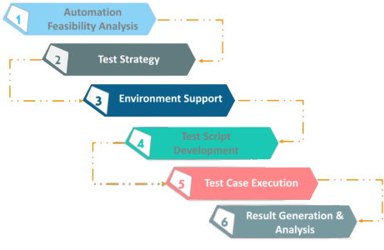
Test Automation Life Cycle:

Slide 7
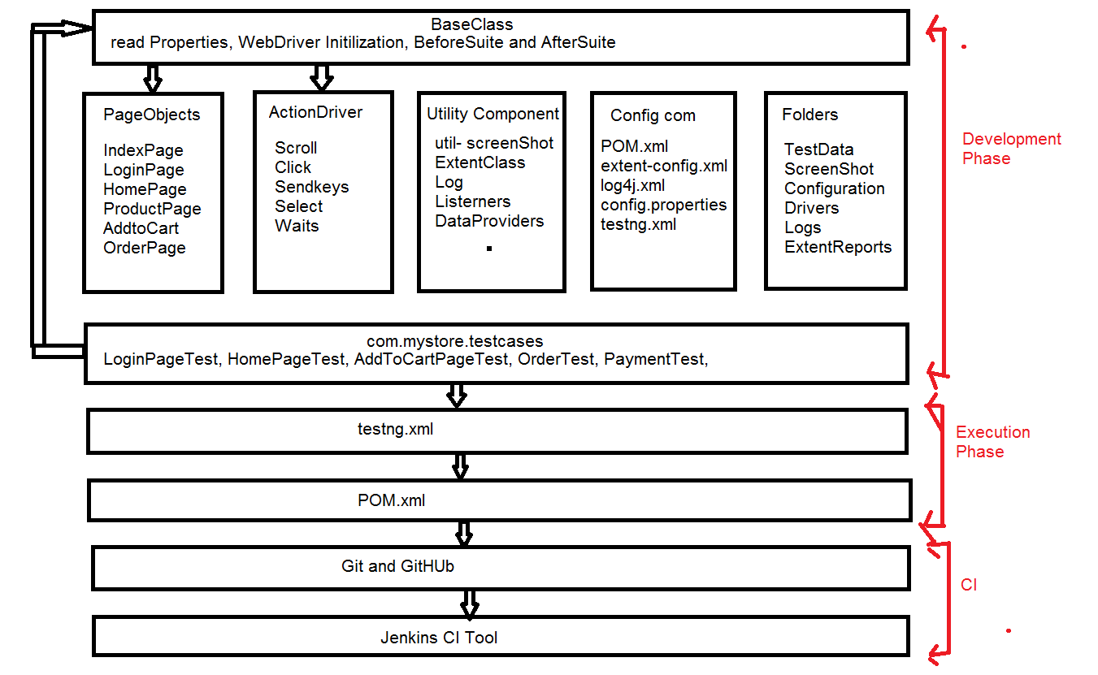
Framework Architecture:

Slide 8
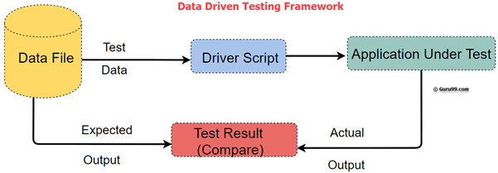
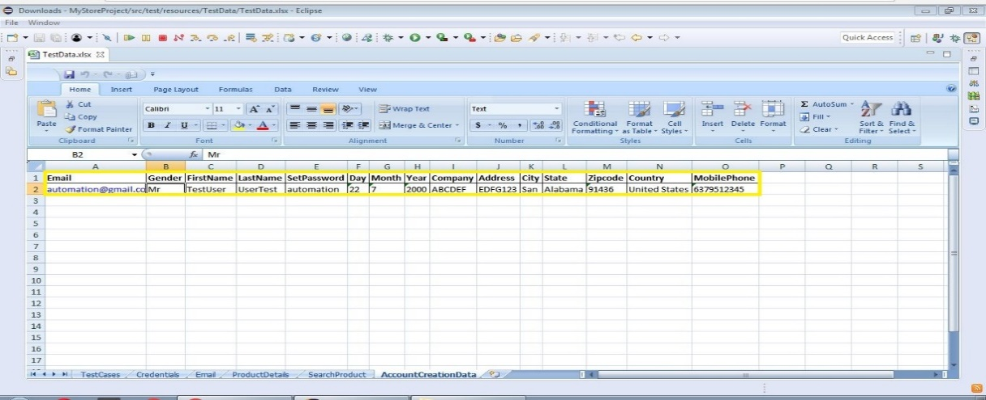

Slide 9
Hardware Requirements:
System : Lenovo
Hard Disk : 500 GB.
Monitor : 14’ Color Monitor
Mouse : Optimal mouse
Ram : 4 GB

Slide 10
Software Requirements:
Operating System : Windows 10 Pro
IDE : Eclipse
Coding Language : JAVA
Testing Tool : Selenium
Framework : POM, Data Driven, TestNG
Testing Tool : Selenium

Slide 11
CONCLUSION
Software testing has a prime importance in software’s verification and validation. It is important because of two main reasons, first, it assures software quality, and second, nearly 60% of the total software’s cost is spend over different types of testing.
Regression testing is the object of interest in this paper and we have detailed the effects of automation of regression tests over the software’s cost, quality and time to market.
Automation of test cases have a high implementation and maintenance costs, from our experiments we have found that, automation of test cases can give remarkable returns in the long runs where we run and rerun the automated-tests, multiple times.

Slide 12
FUTURE WORK
Hence we can claim that test automation increases the overall effectiveness of the testing process when we have repetitive testing tasks which are similar.
This work can be extended in future by adding more variable automation cost factors in the analysis to make it more precise and accurate.
The concept of automatic test data generation can also be combined with the present research.

Slide 13
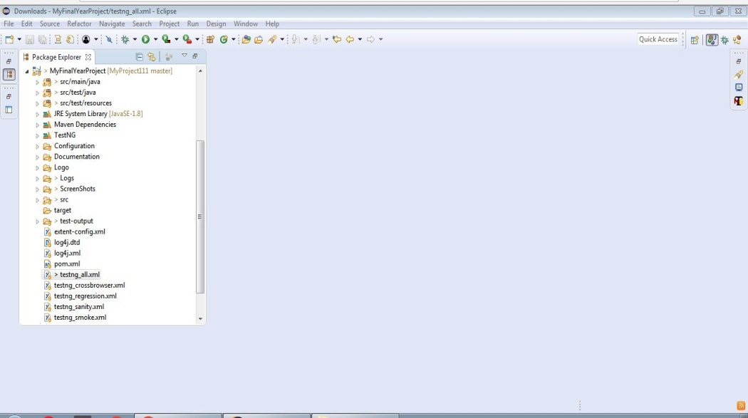
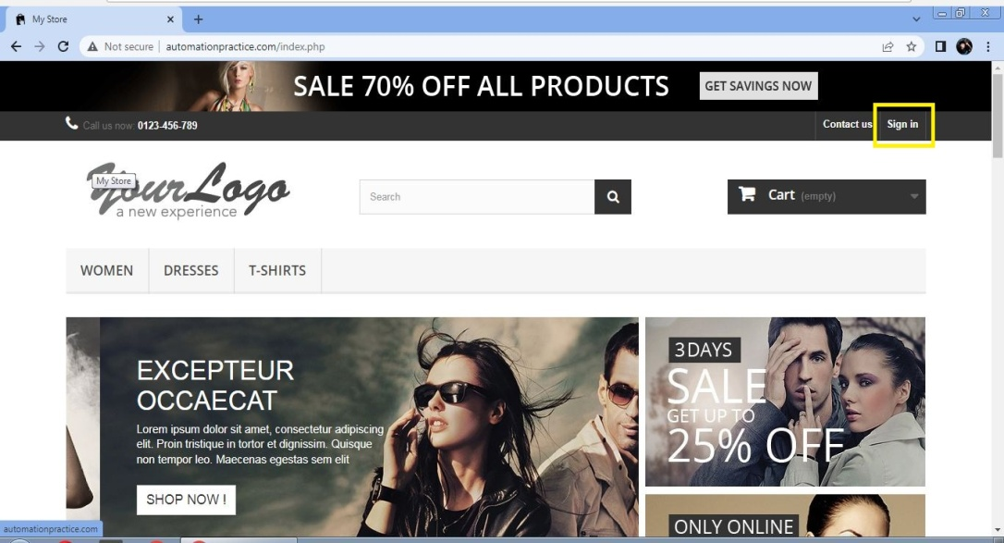
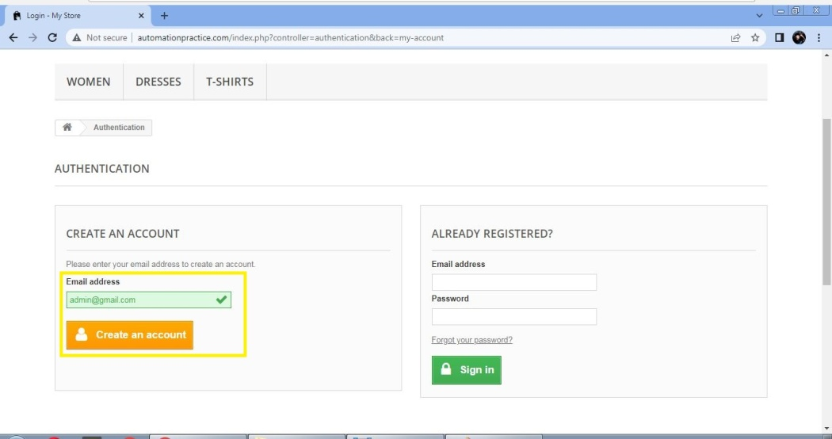
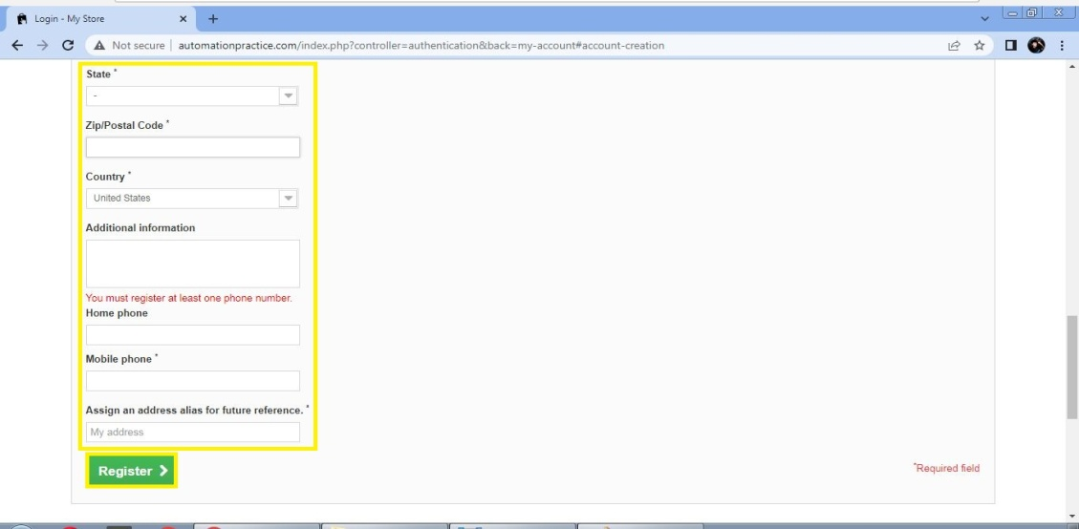
SCREEN SHOT

Slide 14
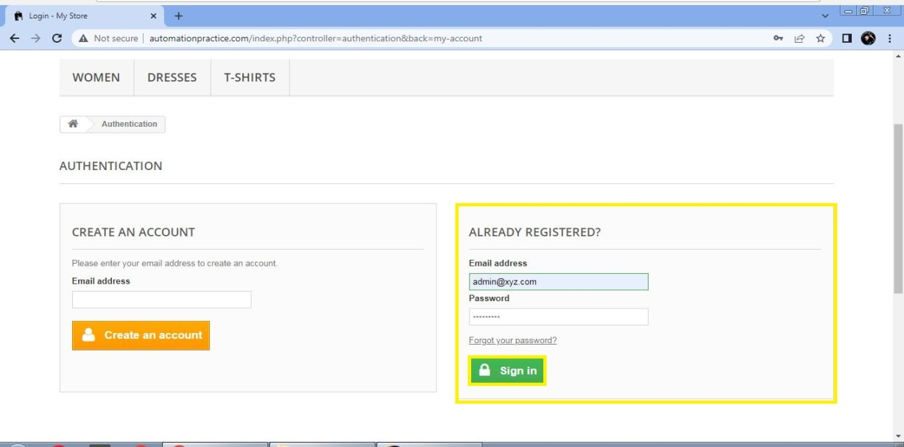
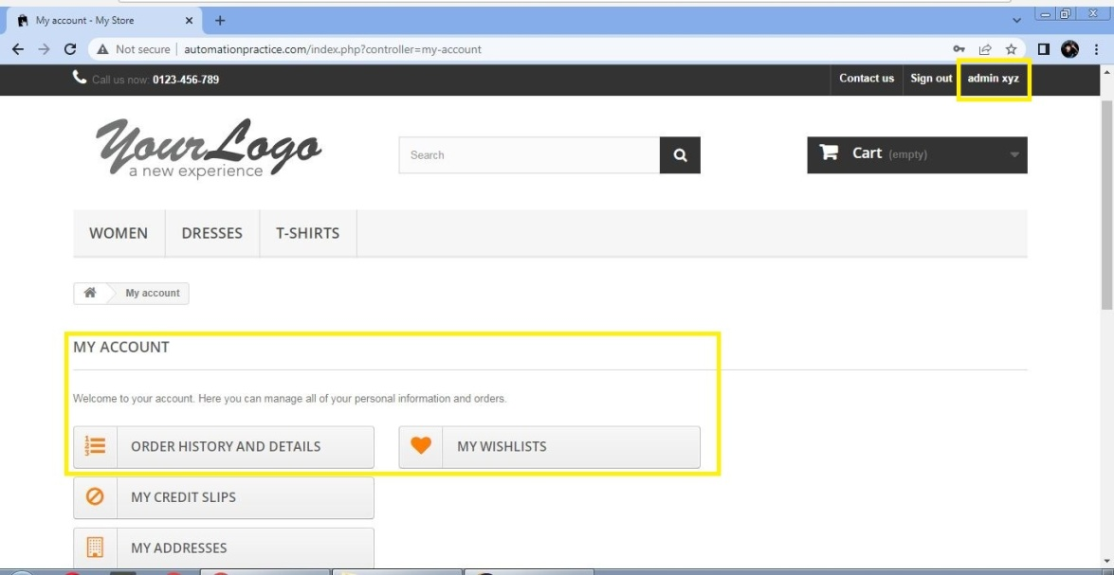
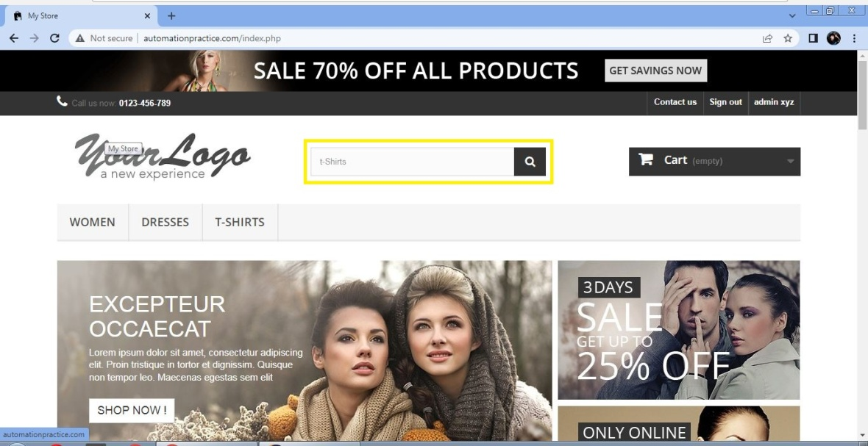
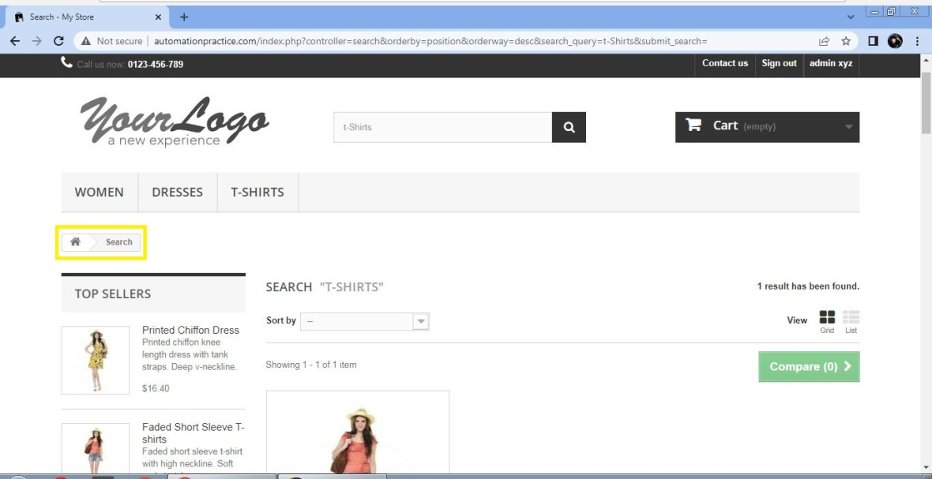

Slide 15
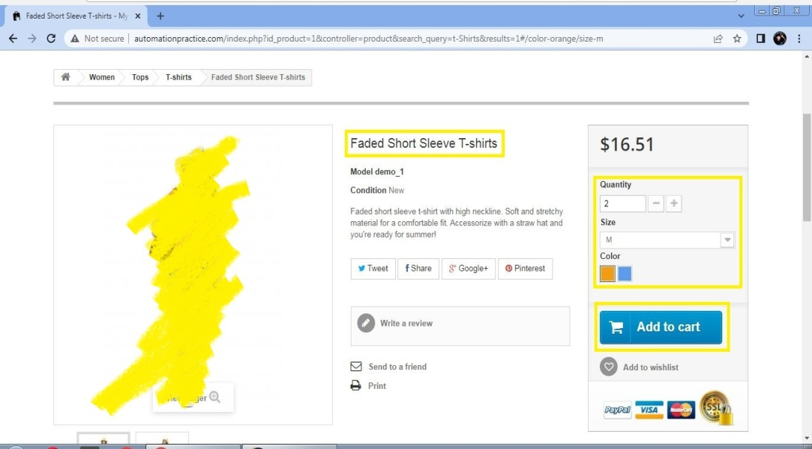
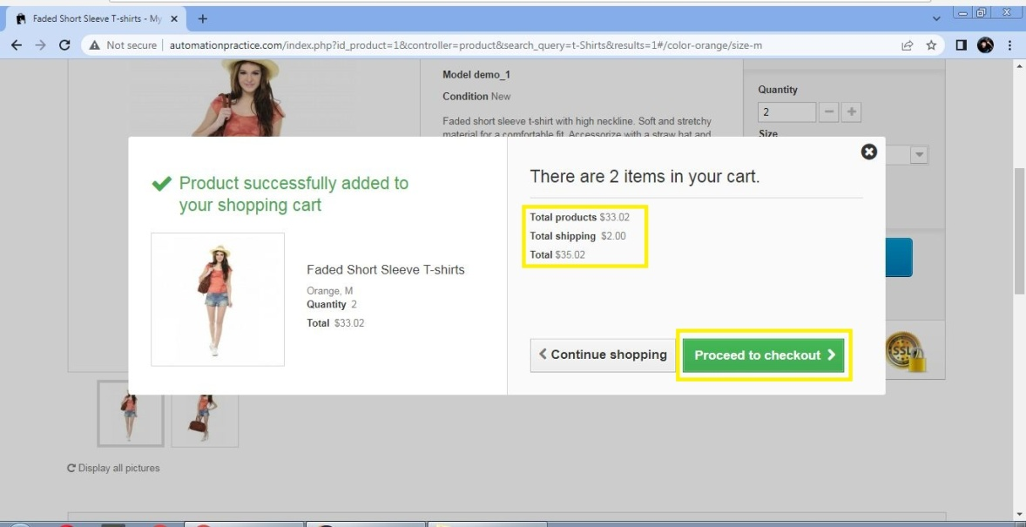
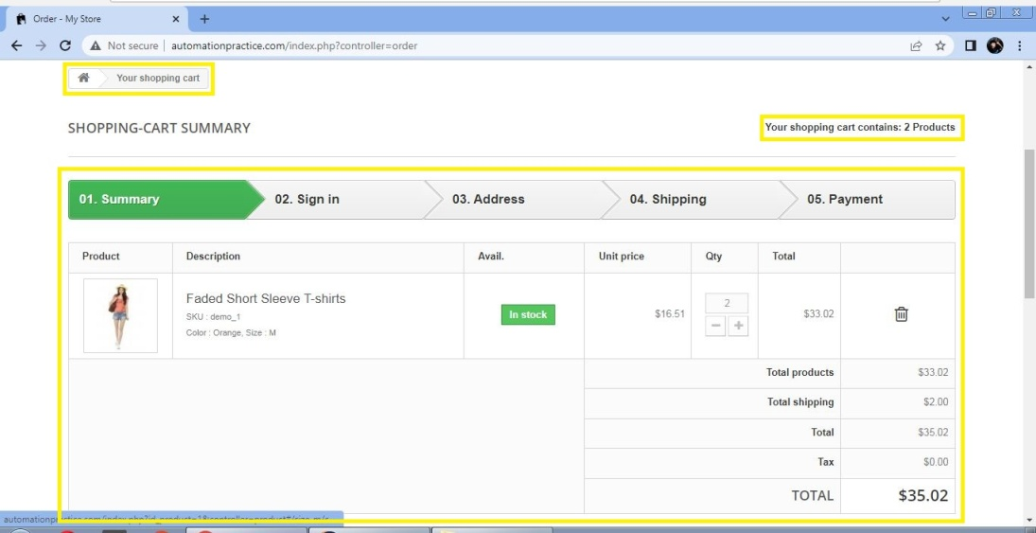
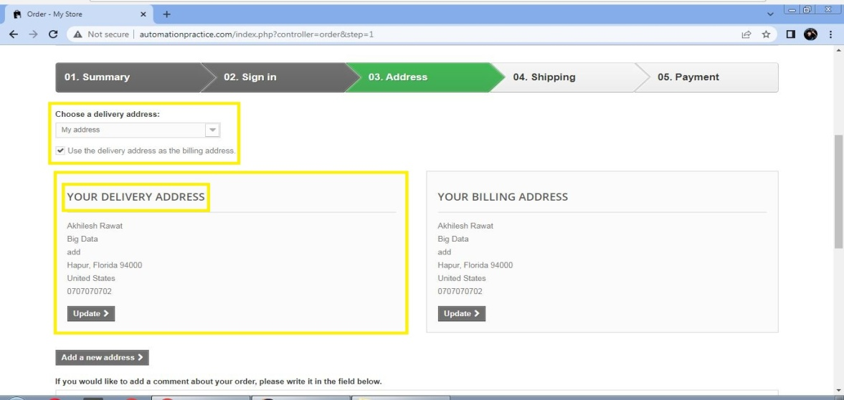

Slide 16
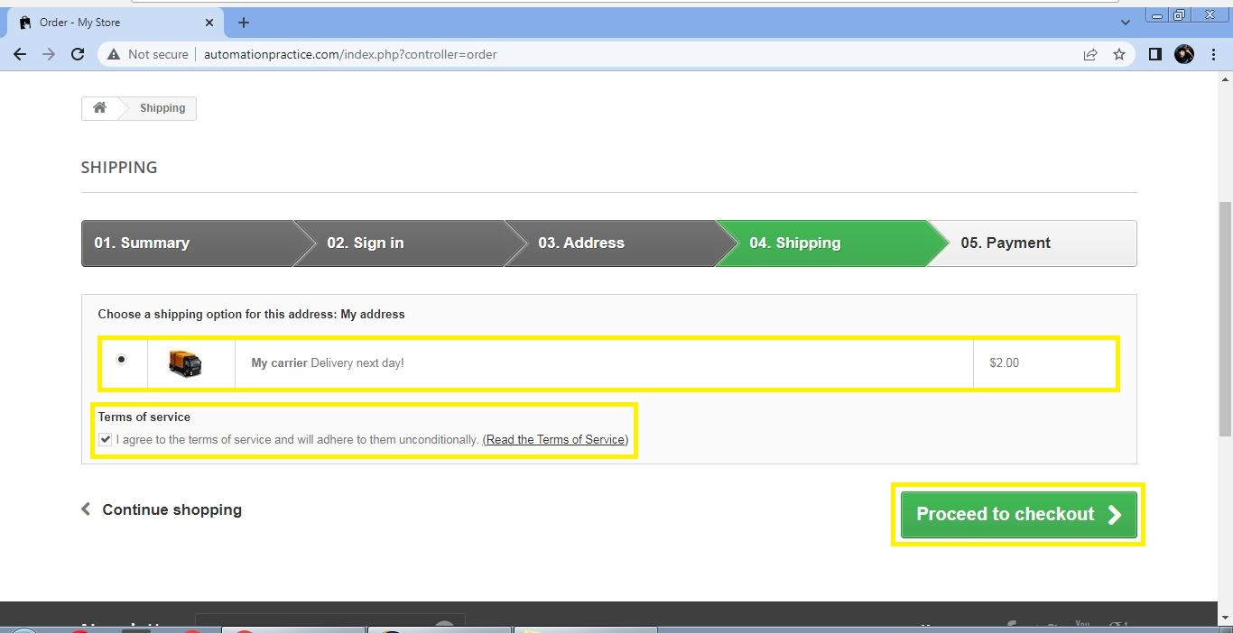
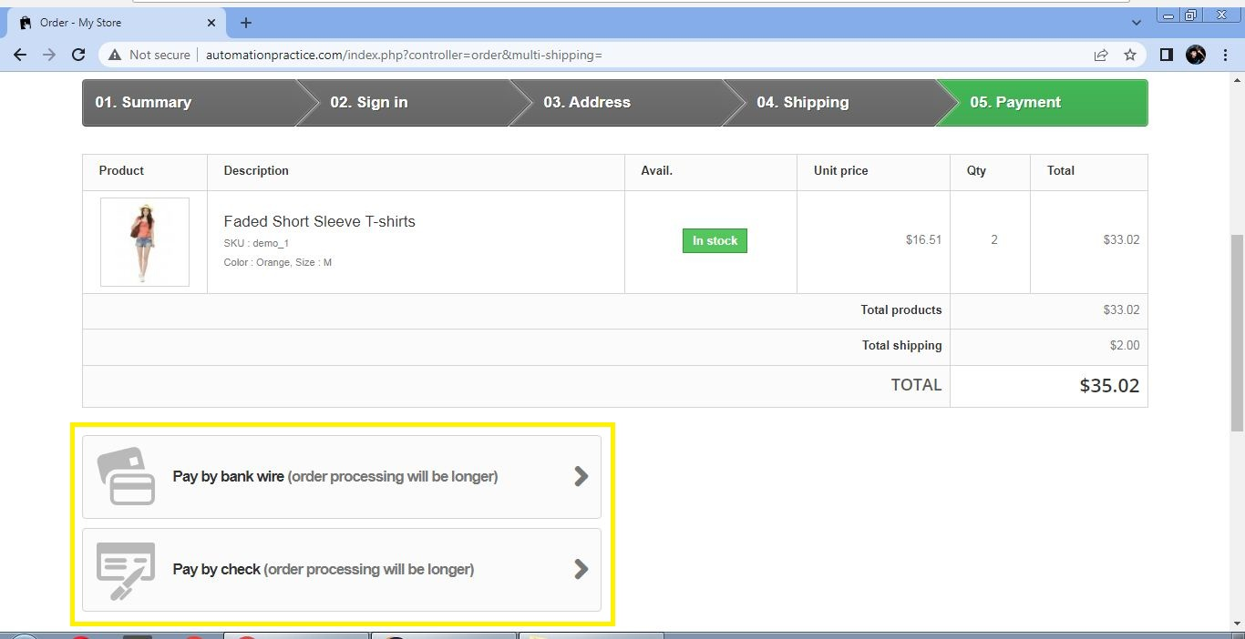

Slide 17
REFERENCE
Dennis, B. H. Wixom, and R. M. Roth, Systems Analysis and Design 5th Edition, 5th Editio. USA: John Wiley & Sons, Inc., 2012.
Padmini, ‘Beginners Guide To Software Testing’, pp. 1–41, 2013
Automated software Testing - International Software Test Institute’. [Online]. Available: https://www.testinstitute.org/Automated_Software_Testing.php. [Accessed: 18-Nov-2019].
Stackify, ‘Code Coverage Tools: 25 Tools for Testing in C, C++, Java’. [Online]. Available: https://stackify.com/code-coverage-tools/. [Accessed: 29-Sep-2019]
Atlassian, ‘About Code Coverage - Atlassian Documentation’, 2017. [Online]. Available: https://confluence.atlassian.com/clover/about-code-coverage-71599496.html. [Accessed: 29-Sep-2019]
Aebersold Kirsten, ‘Test Automation Frameworks’. [Online]. Available: https://smartbear.com/learn/automated-testing/testautomation-frameworks/. [Accessed: 26-Aug-2019].

Slide 18
‘JUnit - Wikipedia’. [Online]. Available: https://en.wikipedia.org/wiki/JUnit. [Accessed: 19-Nov-2019].
Altexsoft.com, ‘Comparing Automated Testing Tools: Selenium, TestComplete, Ranorex, and more | AltexSoft’, 2018. [Online]. Available:https://www.altexsoft.com/blog/engineering/comparing-automated-testing-tools-selenium-testcomplete-ranorex-and-more/. [Accessed: 19-Nov-2019].
Selenium HQ Browser Automation’. [Online]. Available: https://selenium.dev/. [Accessed: 19-Nov-2019]
‘A Comparison of Automated Testing Tools | Katalon Studio’. [Online]. Available: https://www.katalon.com/resourcescenter/blog/comparison-automated-testing-tools/. [Accessed: 17-May-2019].
Brian, ‘Best Automation Testing Tools for 2020 (Top 10 reviews)’, 2017. [Online]. Available: https://medium.com/@briananderson2209/best-automation-testing-tools-for-2018-top-10-reviews-8a4a19f664d2. [Accessed: 20-Nov2019].
worldqualityreport.com, ‘World Quality Report 2019’, 2018.

Slide 19


